Slide 1
Lecture 3
Relational algebra

Slide 2
Relational data model (Codd 1970)
Where does it come from? What benefits does it bring?
Formal abstraction of text files.
Relational calculus and relational algebra (query construction tools).
Methodology for evaluation of relational schema quality.
Methodology for high-quality relational schema design.

Slide 3
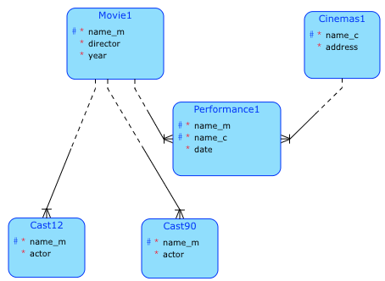
Relational algebra – first example
Entity model:
movie1(name_m, director, year)
cinemas1(name_c, address)
performance1(name_c, name_m, date)
cast12(name_m,actor)
cast90(name_m,actor)
Operations
{movie1(year < 1990)[name_m]*performance1} [name_c]
movie1 <* performance1
cast12[actor] ∪ cast90[actor]
cast12[actor] ∩ cast90[actor]
cast12[actor] - cast90[actor]
movie1 x cinemas1
performance1[name_c,name_m] ÷ { movie1(director=’Woody Allen’) [name_m]}
It is not reasonable to deal with actors in this way with two entities. But I'm putting it here because of the RA pattern.

Slide 4
Relation – concepts
name of attributes [A1, A2, A3, ..., An]
attributes domains Di or dom(Ai):
1.NF: A relation is in first normal form if and only if the domain of each attribute contains only atomic (indivisible) values, and the value of each attribute contains only a single value from that domain.
n-tuple (a1, a2, ..., an) (element of the relation)
set of n-tuples ⊂ D1 × D2... × Dn is relation
relation name R
relation schema R(A1 : D1, A2 : D2, ..., An : Dn), … shortly R(A)
Intuitively (but not exactly, see later):
relation = table
relation schema = table header

Slide 5
Relations vs. database tables 1/3
Lets us consider following tables: Cinemas and Movie
Cinema
Movie
And let us consider relations:
CINEMA(NameC, Address) and MOVIE(NameM, Actor, Year).
Questions:
What is the relationship between relations CINEMA and MOVIE and tables CINEMA* and MOVIE*?
How to design a relation – movie is at the cinema’s program?
We want to assign more actors to one movie. How to do that?
NameC | Address
Blaník | A Street
Vesna | B Street
Mír | C Street
Domovina | D Street
NameM | Actor | Year
Black barons | Vetchý | 1994
Black barons | Landovský | 1994
Top gun | Cruise | 1986
Top gun | McGillis | 1986
Godfather | Brando | 1972
The Freshman | Brando | 1990
The Formula | Brando | 1980

Slide 6
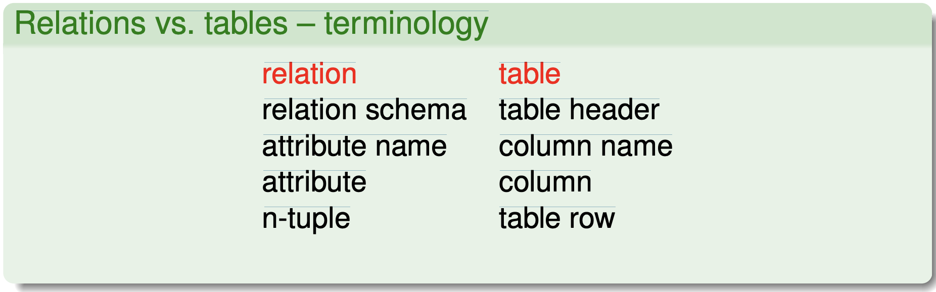
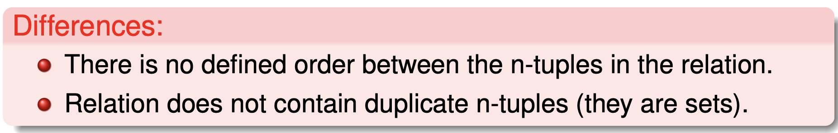
Relations vs. database tables 2/3
What is the relationship between relations CINEMA and MOVIE and tables CINEMA* and MOVIE*?

Slide 7
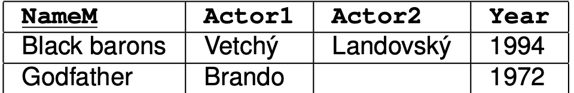
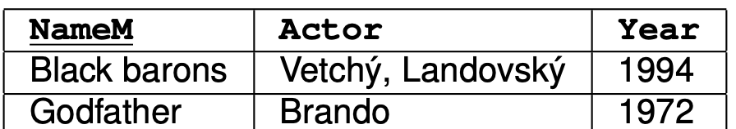
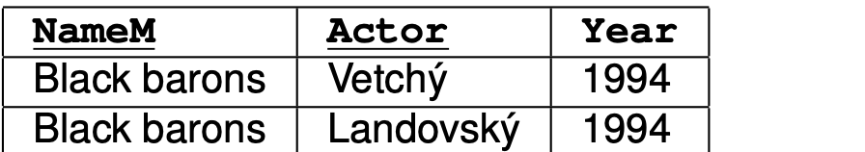
Relations vs. database tables 3/3
We want to assign more actors to one movie. How to do that?
Idea 1: There are more than one actor attribute.
What about if there are more than 2 actors? And if there are less → empty columns.
Idea 2: Multivalued attribute.
Multivalued attributes are not allowed in the relational model. Such relation is not in 1NF.
Idea 3: More rows for one movie.
Unnecessary redundancy, update anomaly. It is not in 2NF.
Detailed discussion and “pure” relational solution – lecture about database normalization.

Slide 8
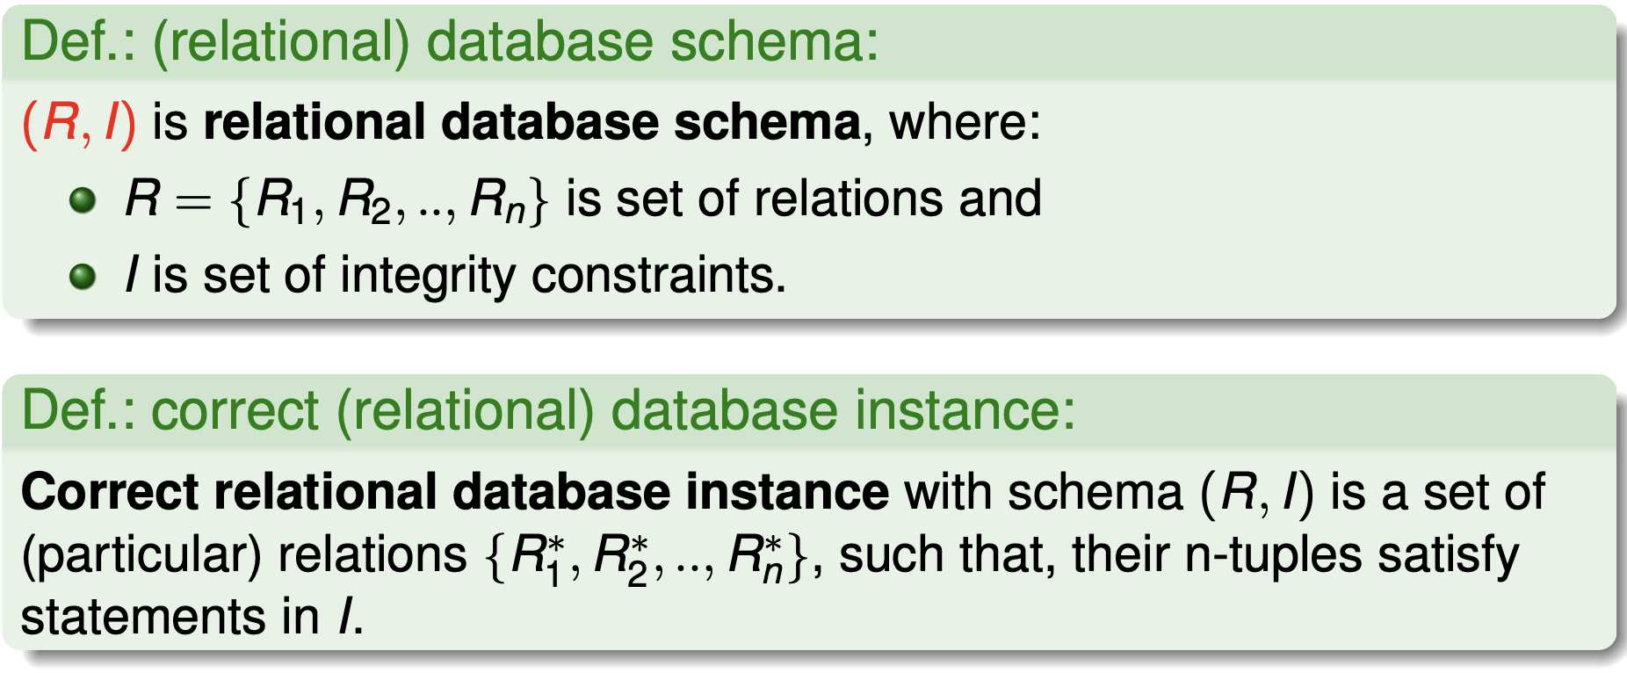
Relational data model
It’s necessary to ensure that only “correct data” gets into the relation – acceptable n-tuples.

Slide 9
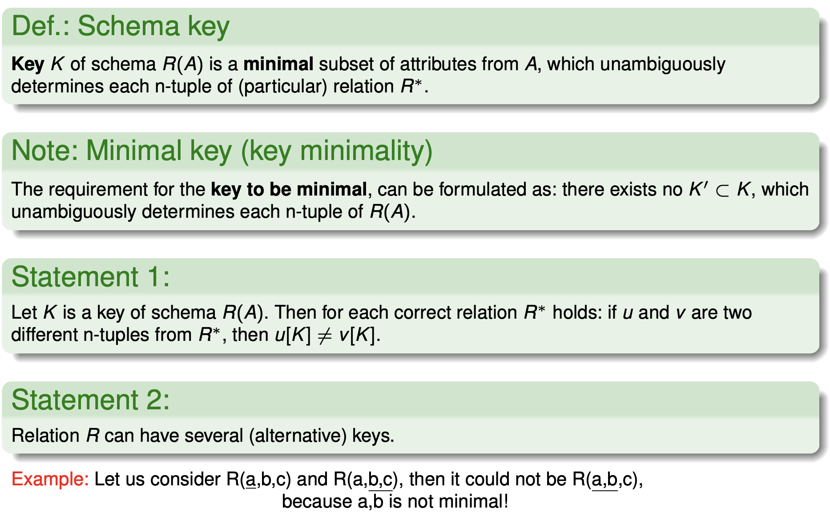
Schema key

Slide 10
Integrity Constraints
Entity:
Cinema (NameC,Address)
Movie (NameM, Actor, Year)
Has_at_program(NameC, NameM,Date)
Integrity Constraints:
IC_1: Primary keys (underline)
IC_2: foreign key:
Has_at_program[NameM] ⊆ Movie[NameM]
Has_at_program[NameC] ⊆ Cinema[NameC]
IC_3: There is no more than 2 performances per week in the cinema.
IC_4: One movie is shown at no more than 3 cinemas.

Slide 11
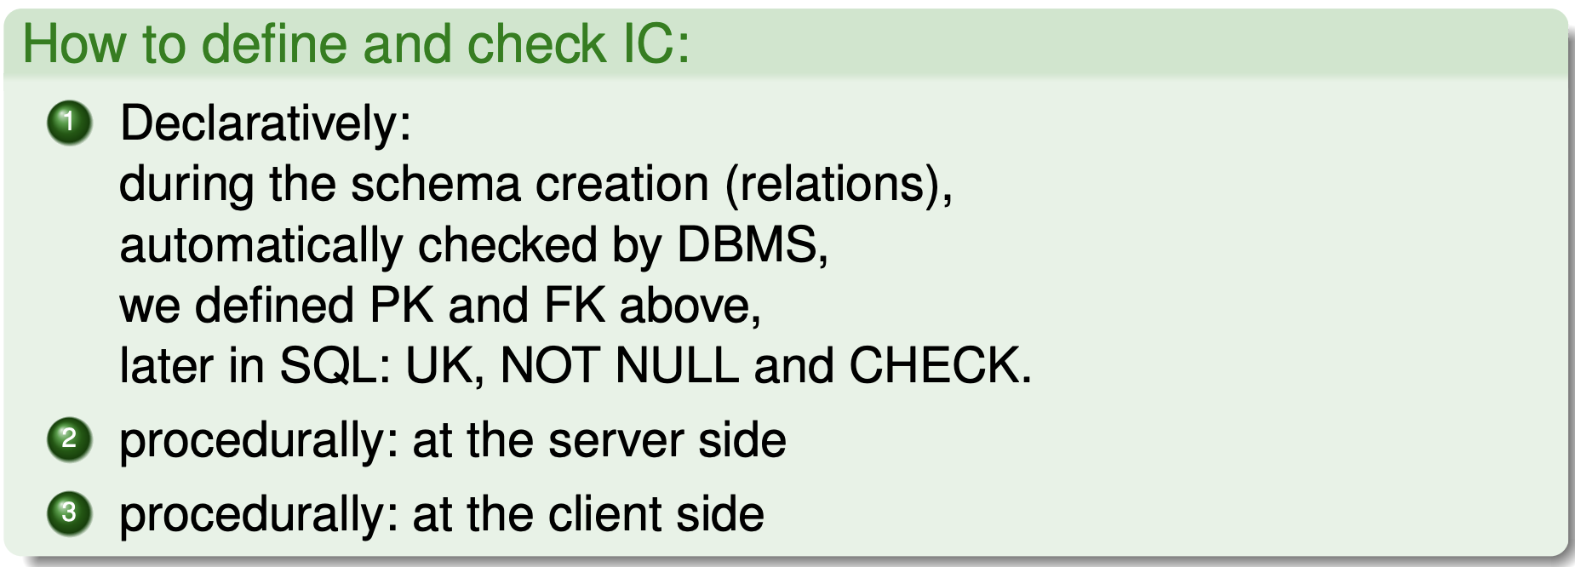
Integrity Constraints and their handling
How to define IC over the database schema?
How to ensure fulfillment of IC?

Slide 12
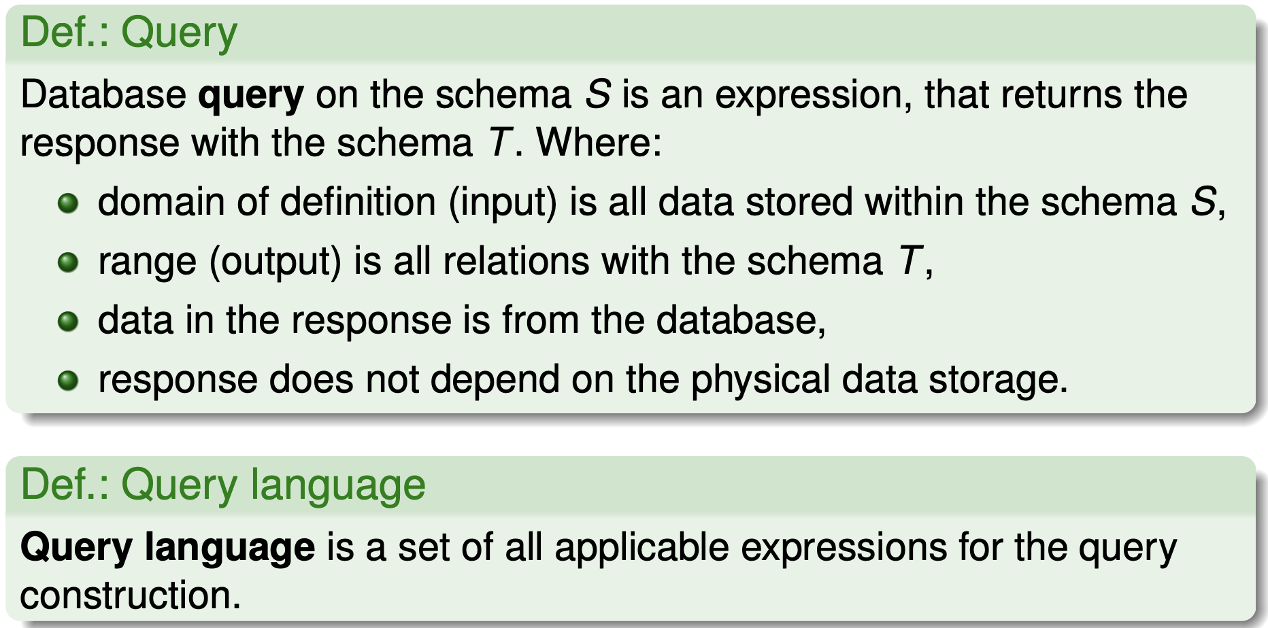
Queries on the schema

Slide 13
Relational data manipulation
insert n-tuple into particular relation.
delete/update n-tuples in particular relation.
The algorithm of manipulation operations contains check of (declarative) IC.
Query specification:
relational algebra,
relational calculus,
SQL.

Slide 14
Relational data model – summary
Relations (tables) are in 1NF,
Attribute domains are atomic (ORDBMS overcome this limit)
Unique n-tuples (rows) within the relation.
Relations are defined as sets. In RDBMS and ORDBMS this is not valid.
Execution of query does not depend on the physical data storage.
Elements of relation (table rows) are accessed according to the content, not the order.
Strong query tools:
(relational algebra, relational calculus, in the RDBMS implementations: SELECT).
Fortunately, there exist methods and approaches for “good” relational model design. They will be presented on the lecture about data normalization.

Slide 15
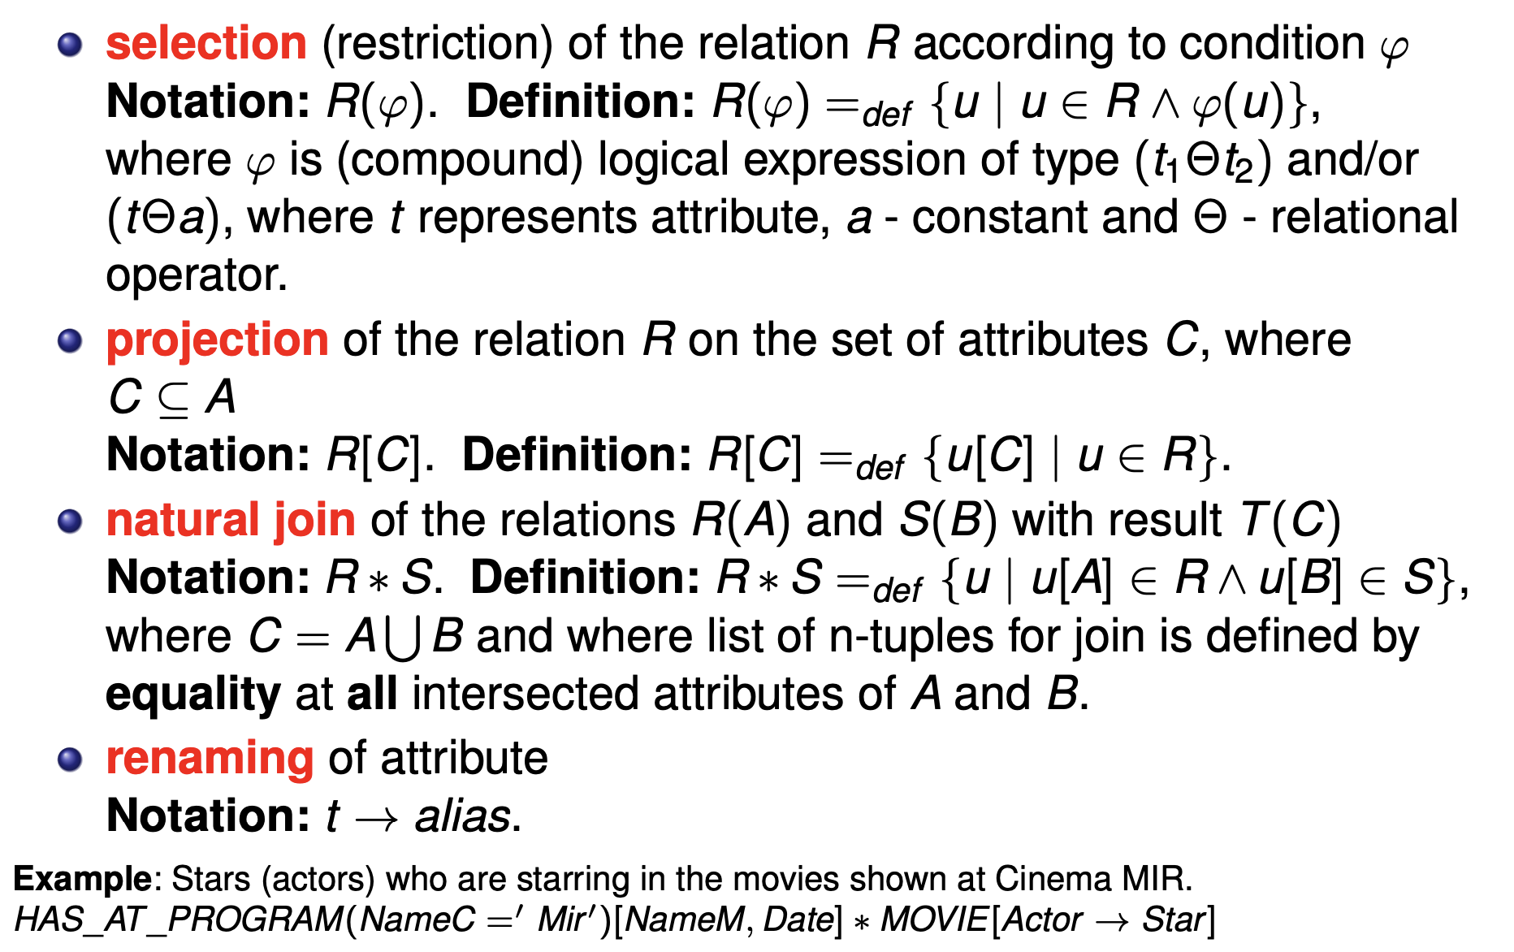
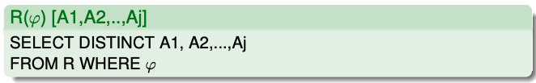
Relational algebra - fundamental operations

Slide 16
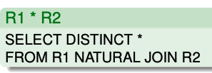
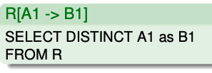
Relational algebra - fundamental operations

Slide 17
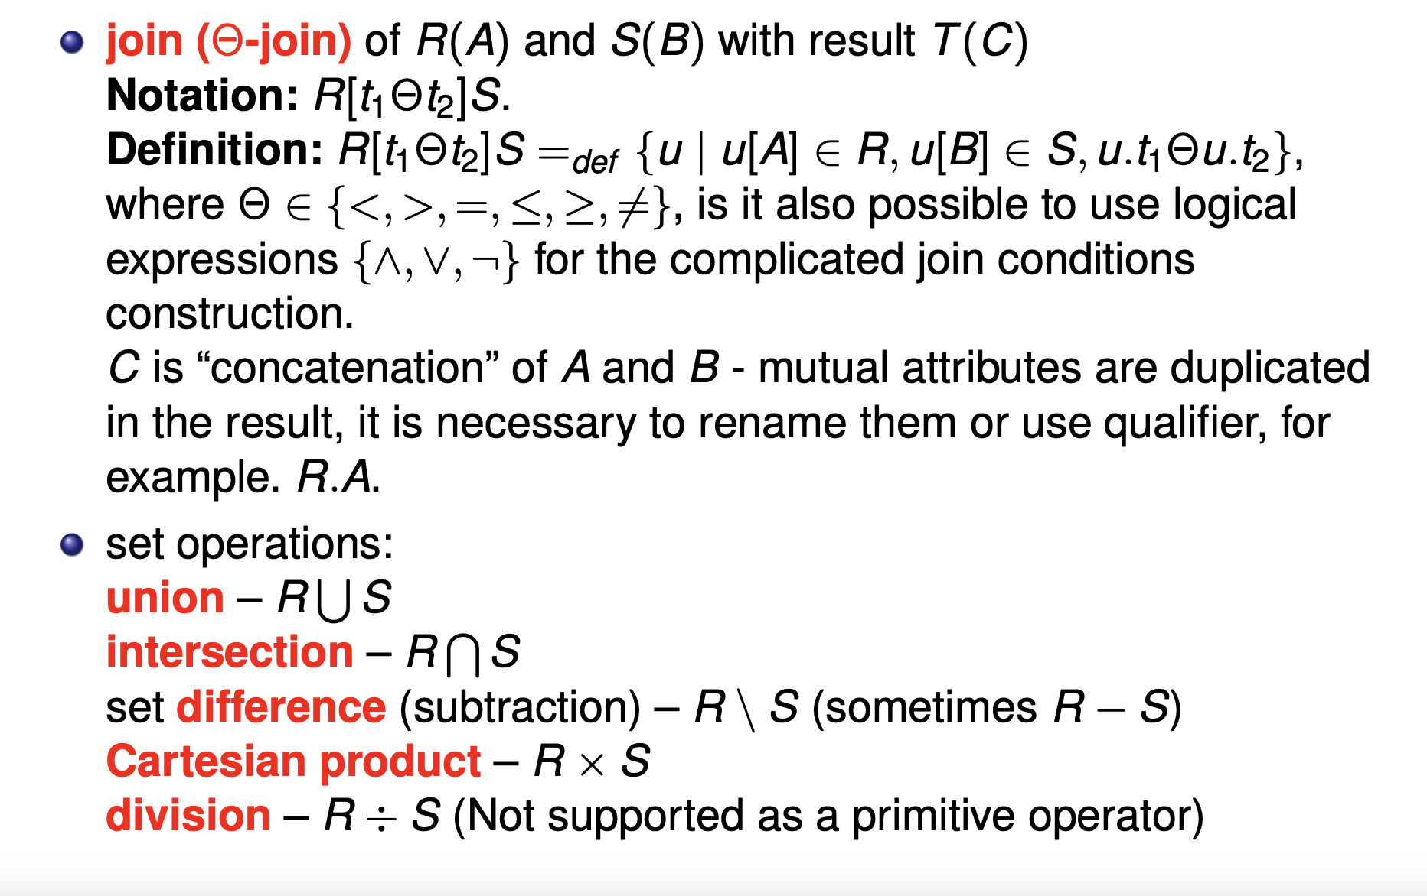
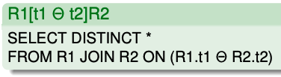
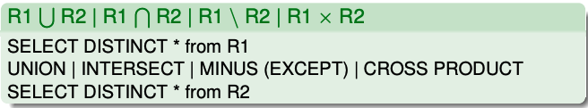
Join operation and set operations

Slide 18
Minimal set of operations
Minimal set of operations RA: {×, selection, projection, →, ∪, \}
Other operations can be expressed using this set.
Example: ∗ or Θ-join with ×, selection, projection.

Slide 19
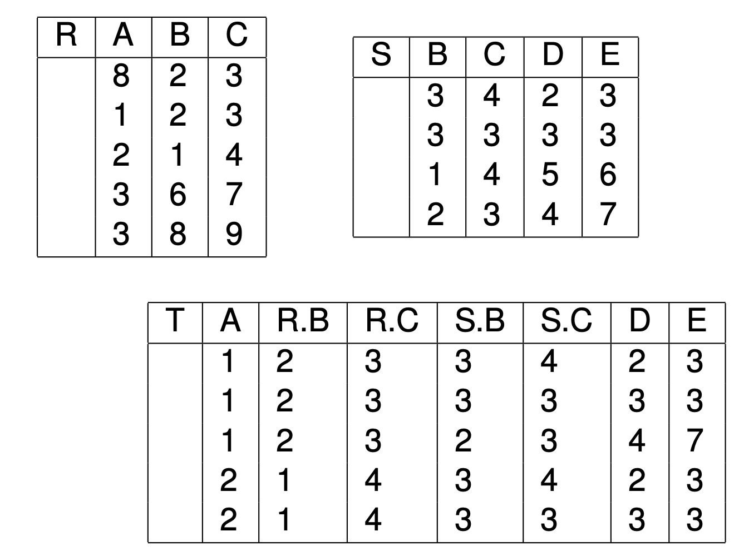
Example: Θ-join
Let us consider relations R(A, B, C) and S(B, C.D, E).
T := R[A < S.B]S.

Slide 20
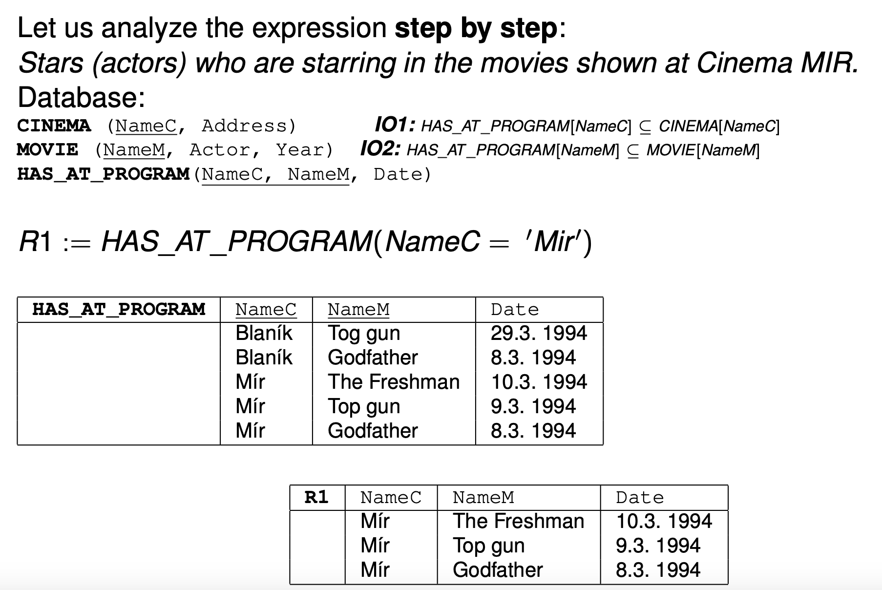
Example: Selection
SELECT DISTINCT * from Has_at_program WHERE NameC = ’Mir’
The blue written commands are examples of implementations of RA using SQL statements. This is SQL not RA commands!!! Don't confuse it.

Slide 21
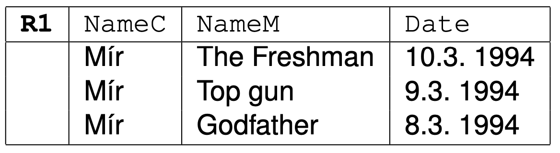
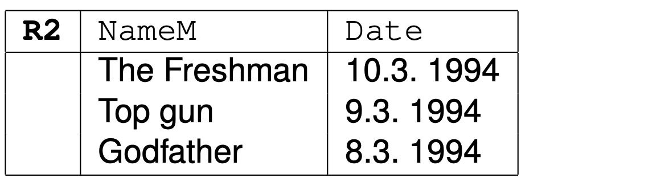
Example: Projection
R2 := R1[NameM, Date]
Original table
SELECT DISTINCT NameM, Date from R1
Projected table

Slide 22
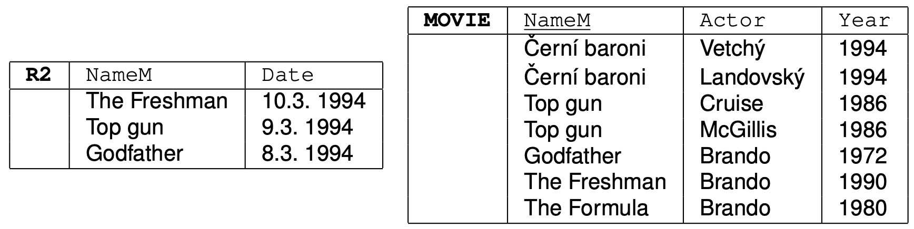
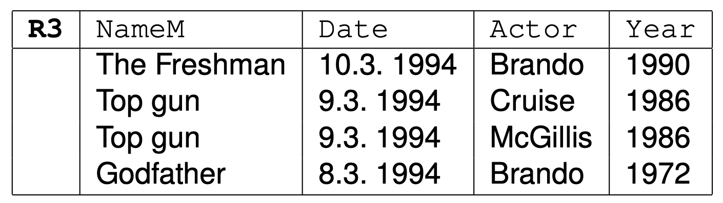
Example: Natural join
R3 := R2 ∗ MOVIE
SELECT DISTINCT * FROM R2 NATURAL JOIN MOVIE
The join was realized via equality of attributes NameM.
Result table

Slide 23
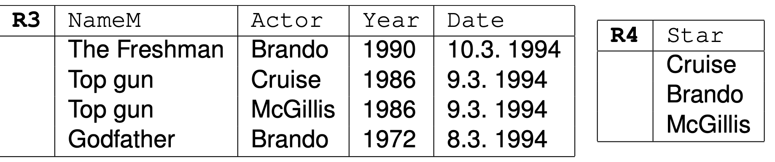
Example: Projection, Selection and Renaming
R4 := R3[Actor → Star]
Note: Thanks to “set” concept in RDM (Relational Data Model) duplicated values are automatically excluded from the relation R4. SQL does not do it automatically. Thanx that we have in all SQL examples which simulates the RA results SQL command DISTINCT.
Example without mid-steps:
Stars (actors), who are starring in the movies shown at Cinema MIR.
{{HAS_AT_PROGRAM(NameC = ‘Mir’ )[NameM, Date]}∗ MOVIE}[Actor → Star]
SELECT DISTINCT Actor as Star from R3

Slide 24
Example: natural join, selection, projection and
renaming
Stars (actors) who star in films shown at the Mír cinema:
RA:
{{Has_at_program(NameC = ‘Mir’ )[NameM, Date]} ∗ Movie} [Actor → Star]
(can be written easily) {Has_at_program ∗ Movie} (NameC = ‘Mir’ )[Actor → Star]
SQL:
SELECT DISTINCT Actor AS Star FROM Has_at_program NATURAL JOIN FILM WHERE NameC = ’Mir’

Slide 25
RA expression evaluation - priorities
evaluated from left to right
selection and projection operations take precedence over binary operations
we use compound brackets to change the priority
Stars (actors) who star in films shown at the Mír cinema:
{{Has_at_program(NameC = ‘Mir’ )[NameM, Date]} ∗ Movie} [Actor → Star]
can be written {Has_at_program ∗ Movie (NameC = ‘Mir’ )}[Actor → Star]
or that and result will be identical {Has_at_program ∗ Movie} (NameC = ‘Mir’ )[Actor → Star]

Slide 26
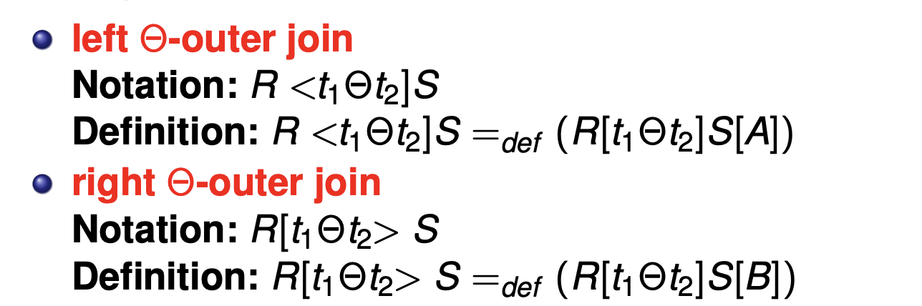


Outer join

Slide 27
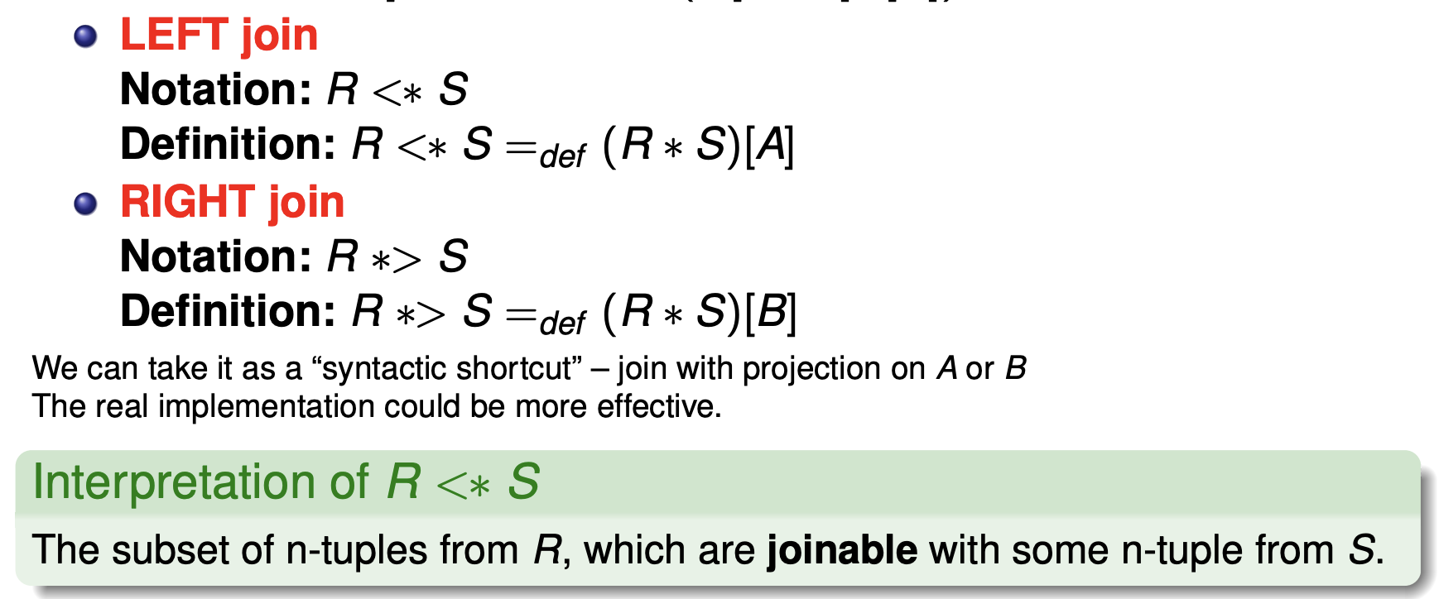
Natural join
Attention, this is a THEORETICAL implementation, it will not work in SQ
SELECT distinct R.* FROM R NATURAL JOIN S

Slide 28
Using of Semi-Join
​​Joins (both semi outer and natural) can be understood as a "syntactic shortcut":
join followed by a projection onto A or B
The actual implementation is usually more efficient than the join a selection.
Interpretation R <∗ S
The subset of tuples from R that are connected to some tuple from S
Cinemas that are showing something (are in the programme).
Films that are performed (are in the programme).

Slide 29
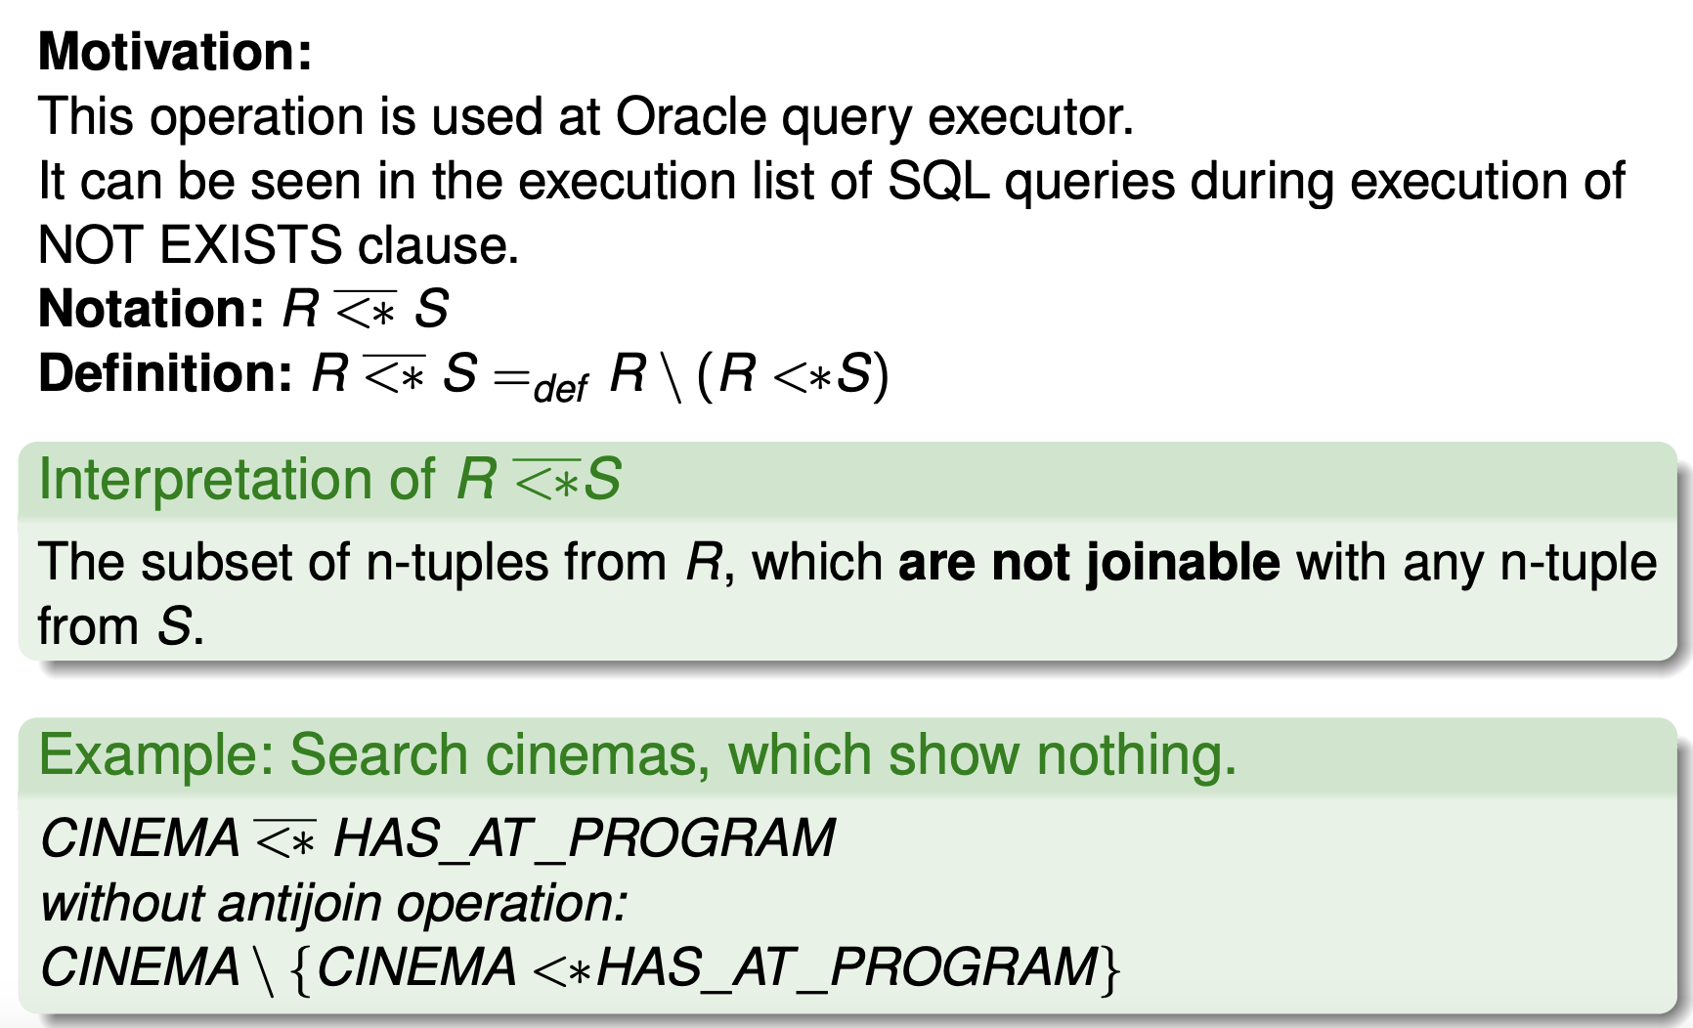
Antijoin

Slide 30
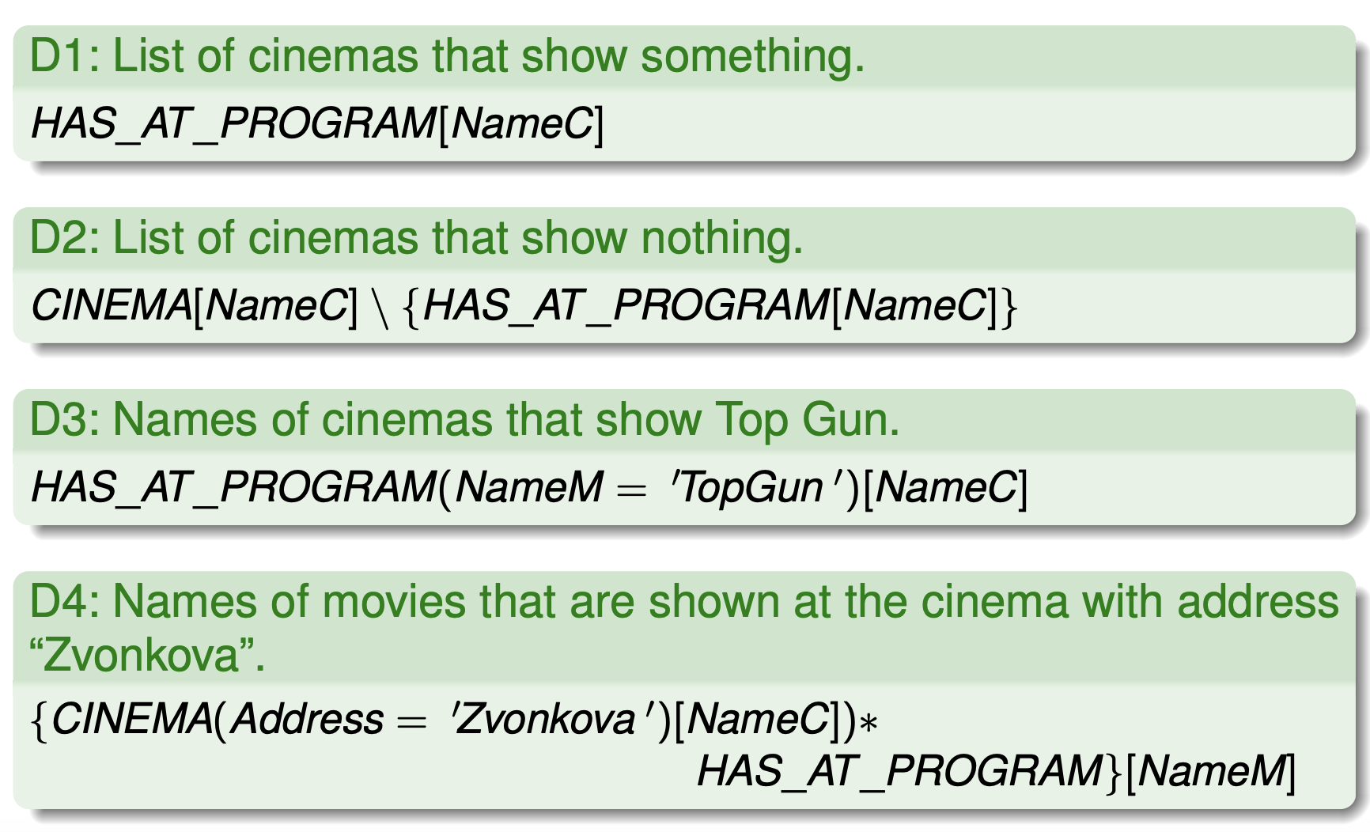
Relational algebra examples 1/5

Slide 31
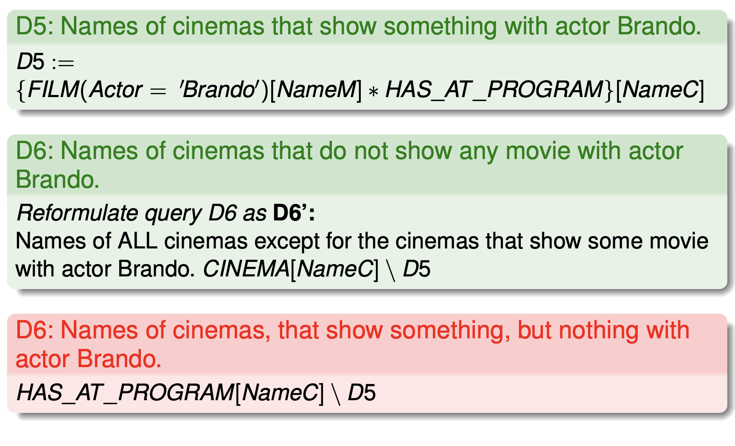
Relational algebra examples 2/5

Slide 32
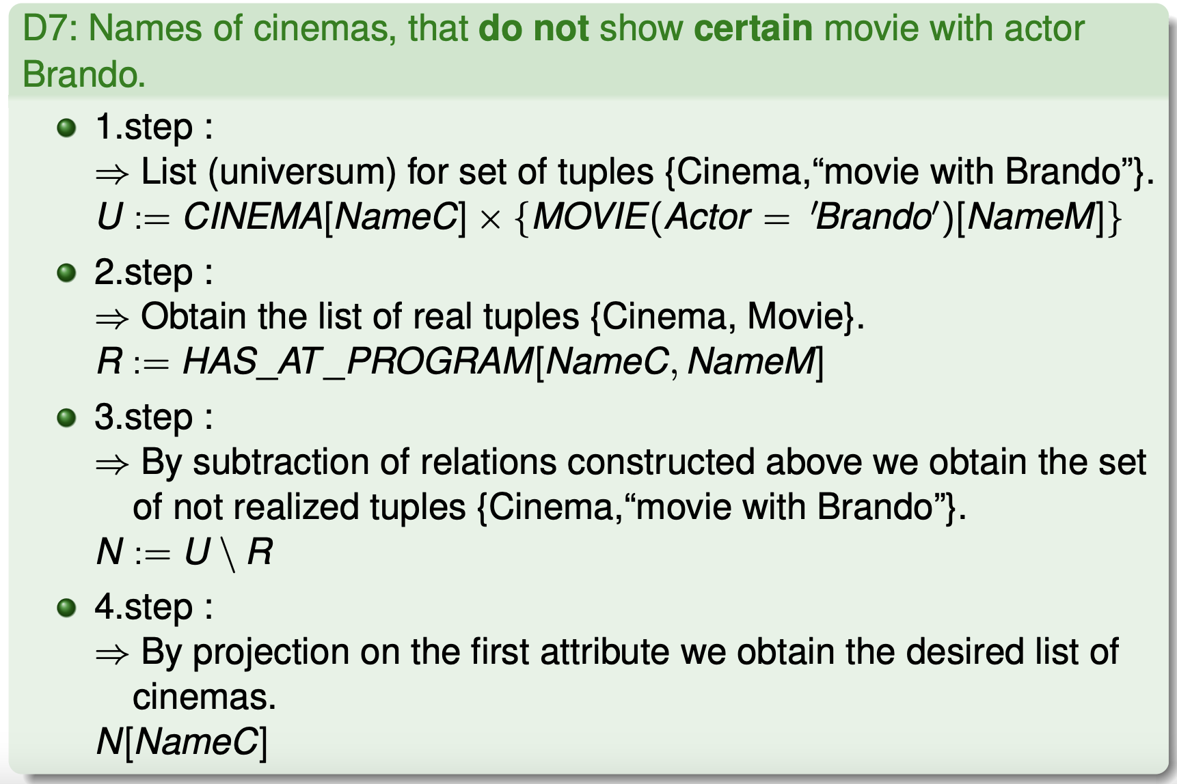
Ex. 3/5: negation (¬) and existential quantifier (∃)

Slide 33
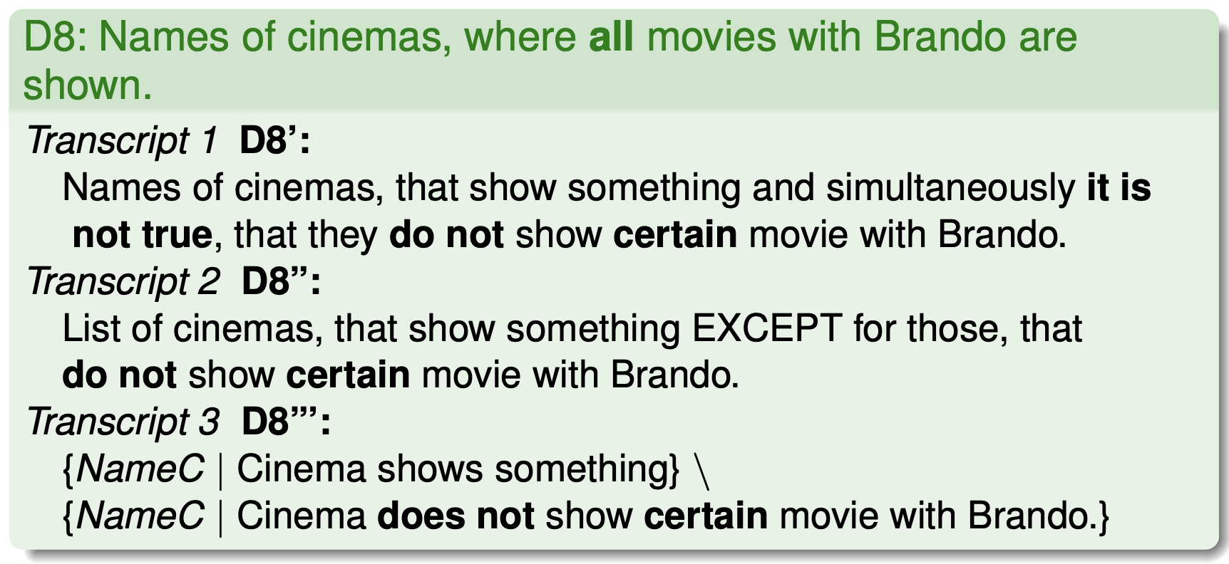
Example 4a/5: universal quantifier (∀)

Slide 34
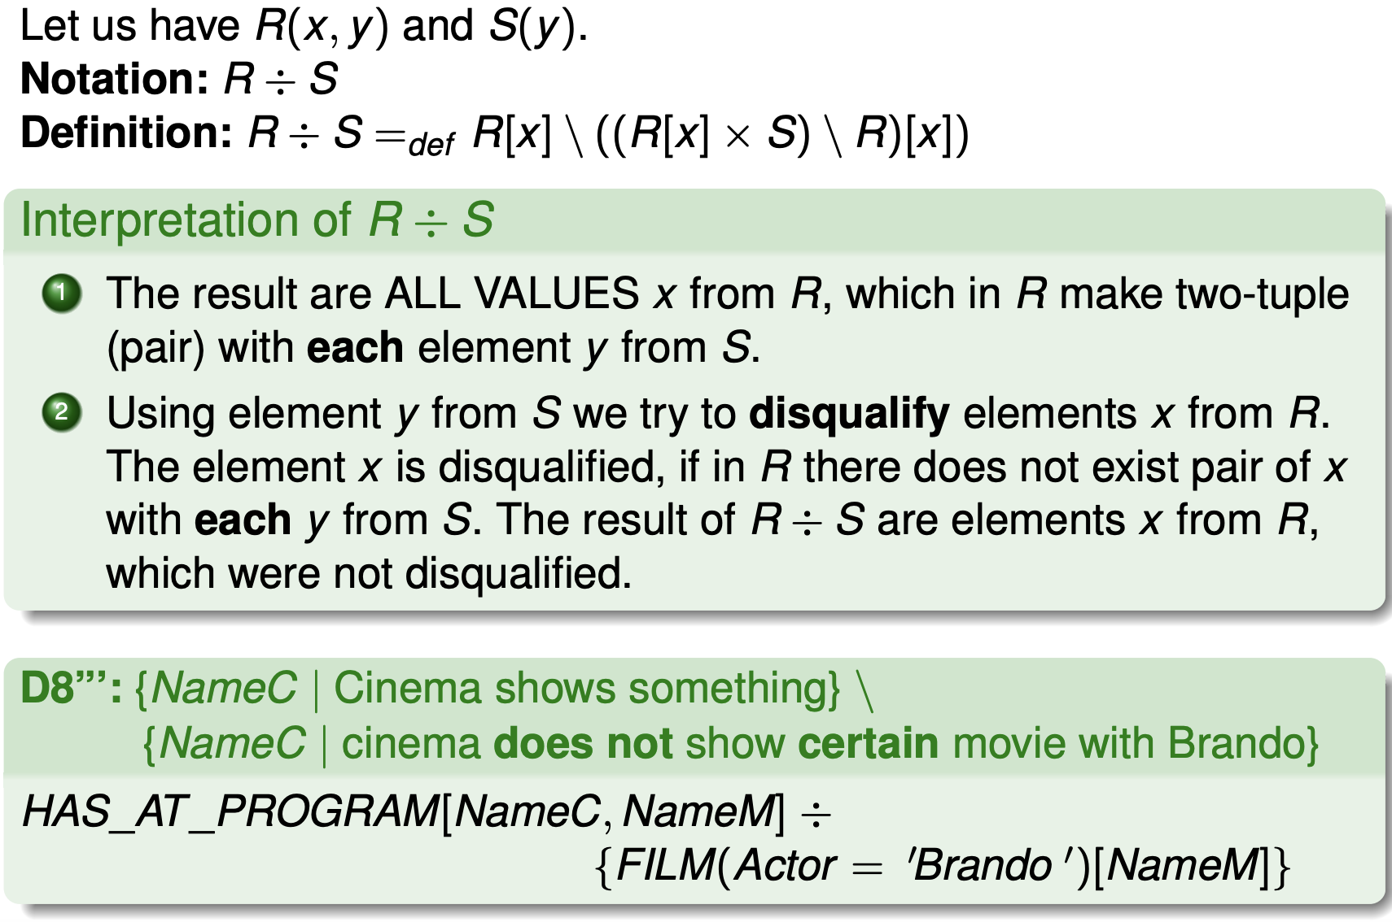
Example 4b/5: database division (÷)

Slide 35
Pay attention to the formula of the query
You need to understand the query correctly to deploy the correct "template". Examples:
Cinemas that play some (at least one) Brando movie.
Cinemas that do not play any Brando film. To be included/not to be included cinemas that do not play Brando at all?
Cinemas that play only Brando films (category C of the semester)
Cinemnas that do not play any Brando films.
Cinemas that play any (all) Brando films (category D in the semester work editor)
All of these types of questions will be tested on the midterm and will also be the subject of the midterm and exam.

Slide 36
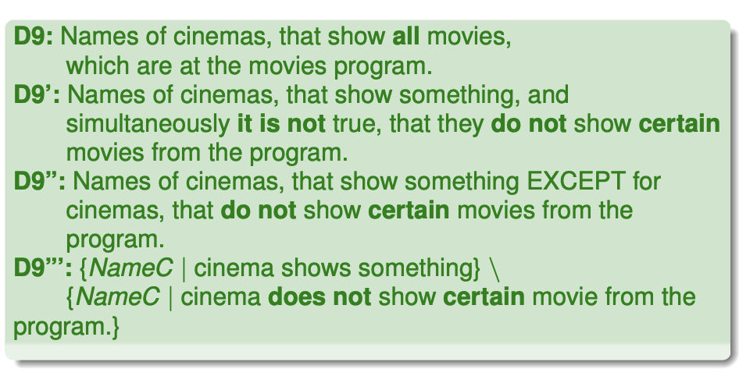
Relational algebra examples 5/5

Slide 37
Relational algebra examples 5/5
Names of cinemas, that show all movies, which are at the movies program.
1 without ÷
1. step: C := HAS_AT_PROGRAM[NameC]
2. step: U := C × {HAS_AT_PROGRAM[NameM]}
3. step: R := HAS_AT_PROGRAM[NameC, NameM]
4. step: N := U \ R
5. step: B := N[NameC]
6. step: C \ B
2 with ÷
HAS_AT_PROGRAM[NameC, NameM] ÷ {HAS_AT_PROGRAM[NameM]}

Slide 38
Relational algebra and programming
Relational algebra is a "higher" language.
We don't specify "how to do things" (typically 3GL), but "what should be the result".
On the other hand, it is a very highly specialized language.
A query language that allows to implement relational algebra is called relational complete .
The commercial world:
SQL SELECT (is relationally complete)
Form languages (they are not relationally complete)
Graphical (images) languages (are not relationally complete)

Slide 39
Relational algebra characteristics
It cares "only" selecting not DML and DDL.
The result of a query is a result that can be the input of another query - queries can be chained.
Expressions (queries) consist of operations and an operand.
The operand is always the entire session.
Relational algebra was the model for the design of the SELECT statement in SQL.
SQL SELECT currently has more expressive power than RA (aggregation, outer joins, nested queries, ordering, AVG,SUM…).

Slide 40
What do you should remember
Relation is a set of n- tuples.
IC: key(primary, alternative), foreign keys
attributes in the session model are atomic
Relational algebra and its operations:
selection, projection, renaming
set operations
semi-join, antijoin
negation, quantifiers
relational division
RA is a query language (does not resolve DML and DDL)

